Slide 1
RKTiwary
COA -IS ZC353

Slide 2
Reducing Cache Misses by More Flexible Placement of Blocks
Fully associative cache:
A cache structure in which a block can be placed in any location in the cache.
Set-associative cache:
A cache that has a fixed number of locations (at least two) where each block can be placed.
A set-associative cache with n locations for a block is called an n-way set-associative cache

Slide 3
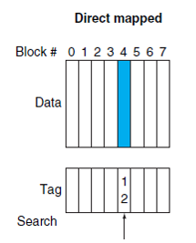
The location of a memory block whose address is 12
Direct-mapped cache
(Block number) modulo (Number of blocks in the cache)
In direct-mapped placement, there is only one cache block where
memory block 12 can be found, and that block is given by (12 modulo 8) = 4.

Slide 4
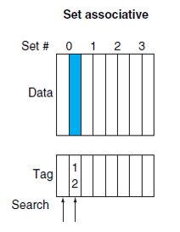
The location of a memory block whose address is 12
Set-associative cache, set number
(Block number) modulo (Number of sets in the cache)
In a two-way set-associative cache, there would be four sets, and memory block 12 must be in set (12 mod 4) = 0;
the memory block could be in either element of the set

Slide 5
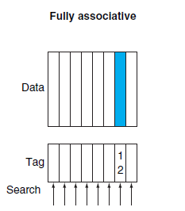
The location of a memory block whose address is 12
Set-associative cache, set number
(Block number) modulo (Number of sets in the cache)
In a fully associative placement,
the memory block for block address 12 can appear in any of the eight cache blocks.

Slide 6
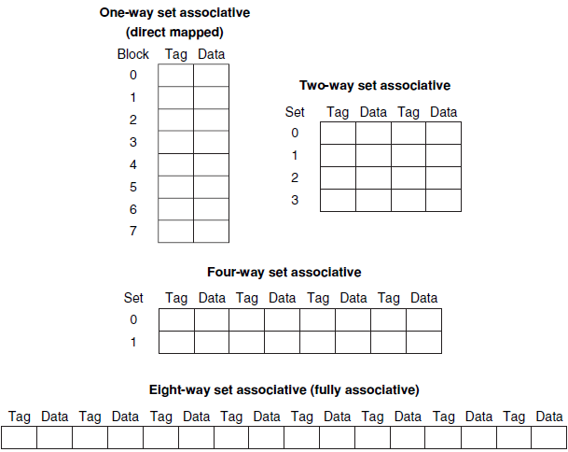
A direct-mapped cache :a one-way set-associative cache:
A fully associative: cache with m entries is simply an m-way set-associative cache; it has one set with m blocks, and an entry can reside in any block within that set

Slide 7
Example
Assume there are three small caches, each consisting of four one-word blocks. One cache is fully associative, a second is two-way set-associative, and the third is direct-mapped. Find the number of misses for each cache organization given the following sequence of block addresses: 0, 8, 0, 6, and 8.
Block Adrs | Cache block
0 | (0 modulo 4)=0
6 | (6 modulo 4)=2
8 | (8 modulo 4)=0
Memory Adr | Hit/Miss | Content of the cache
 |  | Block0 | Block1 | Block2 | Block3
0 | miss | 0
8 | Miss | 8
0 | Miss | 0
6 | Miss | 0 |  | 6
8 | miss | 8

Slide 8
Set Associative
Two way means there are two sets with indices 0 and 1
Block Adrs | Cache Set
0 | (0 modulo 2)=0
6 | (6 modulo 2)=0
8 | (8 modulo 2)=0
Set-associative caches usually replace the least recently used block within a set
Memory Adr | Hit/Miss | Content of the cache
 |  | set0 | set0 | Set1 | Set1
0 | miss | 0
8 | Miss | 0 | 8
0 | Hit | 0 | 8
6 | Miss | 0 | 6
8 | miss | 8

Slide 9
Fully Associative
Memory Adr | Hit/Miss | Content of the cache
 |  | Block0 | Block1 | Block2 | Block3
0 | miss | 0
8 | Miss | 0 | 8
0 | Hit | 0 | 8
6 | Miss | 0 | 8 | 6
8 | Hit | 0 | 8 | 6

Slide 10
What is when the block size is 8
For two way set Associative we have 2 Sets (0,1)
Memory Adr | Hit/Miss | Contents of cache blocks after reference
 |  | Set0 | Set0 | Set0 | Set0 | Set1 | Set1 | Set1 | Set1
0 | M | 0
8 | M | 0 | 8
0 | H | 0 | 8
6 | M | 0 | 8 | 6
8 | H | 0 | 8 | 6
there would be no replacements in the two-way set-associative cache;
and it would have the same number of misses as the fully associative cache.
Check for yourself.: if we had 16 blocks, all 3 caches would have the same number of misses

Slide 11
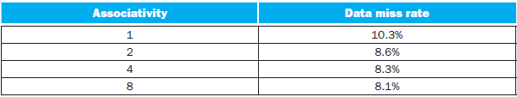
How much of a reduction in the miss rate is achieved by associativity?
for a 64 KB data cache with a 16-word block
Going from one-way(direct) to two-way associativity decreases the miss rate by about 15%, but there is little further improvement in going to higher associativity.

Slide 12
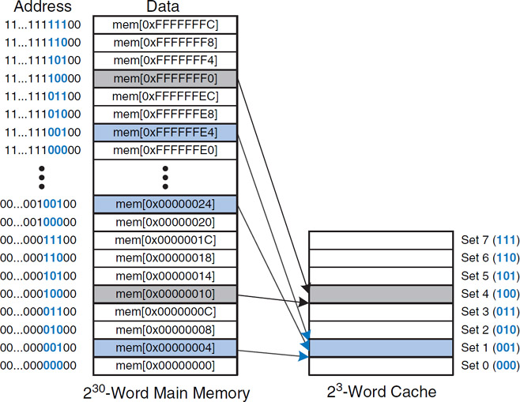
To explore
To what cache set in Figure does the word at address 0x00000014 map? Name another address that maps to the same set.

Slide 13
Solution
0x00000014 H
Representing only lower byte : 0001 0100
The two least significant bits of the address are 00, because the address is word aligned.
So the alignment is 101 00
The next three bits are 101, so the word maps to set 5.
The other address are 0001 0100 to xxx1 0100
Or for that matter in Hex xxxxxx14 and in increment of 20H
Words at addresses 0x34, 0x54, 0x74, …, 0xFFFFFFF4 all map to this same set.

Slide 14
Locating a Block in the Cache
Index value is used to select the set
tags of all the blocks in the set must be searched
associativity increases
Block per set increases
Associativity increases by 2
Number of blocks increase by 2
Index bit reduces by 1 bit
increases the size of the tag by 1 bit

Slide 15
EXAMPLE:
Suppose we have a processor with a base CPI of 1.0, assuming all references hit in the primary cache, and a clock rate of 4 GHz.
Assume a main memory access time of 100 ns, including all the miss handling.
Suppose the miss rate per instruction at the primary cache is 2%.
How much faster will the processor be if we add a secondary cache that has a 5 ns access time for either a hit or a miss and is large enough to reduce the miss rate to main memory to 0.5%?

Slide 16
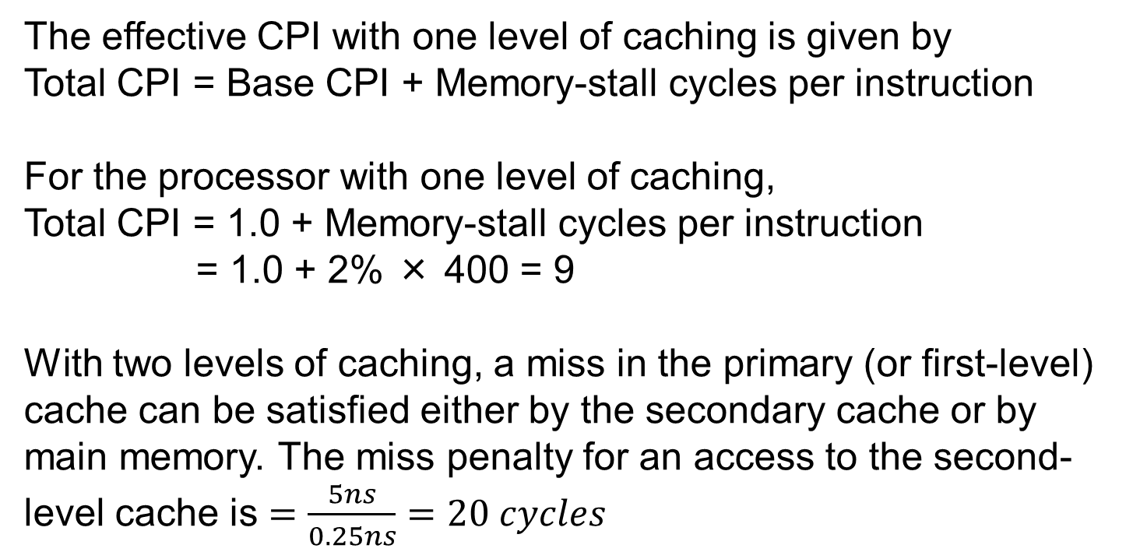
Solution
The miss penalty to main memory is $=\frac{100ns}{0.25ns}=400 cycles$
The effective CPI with one level of caching is given by
Total CPI = Base CPI + Memory-stall cycles per instruction
For the processor with one level of caching,
Total CPI = 1.0 + Memory-stall cycles per instruction
= 1.0 + 2% × 400 = 9
With two levels of caching, a miss in the primary (or first-level) cache can be satisfied either by the secondary cache or by main memory. The miss penalty for an access to the second-level cache is $=\frac{5ns}{0.25ns}=20 cycles$

Slide 17
Thus, for a two-level cache, total CPI is the sum of the stall cycles from both levels of cache and the base CPI:
Total CPI = 1 + Primary stalls per instruction + Secondary stalls per instruction
= 1 + 2% × 20 + 0.5% × 400
= 1 + 0.4 + 2.0 = 3.4
Thus, the processor with the secondary cache is faster by
9.0/3.4= 2.6

Slide 18
Comparison of different cache mapping, Directly Mapped cache, set associative and fully associative
First flush the contents of the cache by clicking on the FLUSH button. Then enter the following instructions after the last LDB instruction in the above program:
LDB 0, R00
LDB 4, R00
LDB 17, R00
LDB 20, R00
Now select the option
Block Size = 4
Cache Type = Set Associative
Cache Size = 16
Set Blocks = 2-way
Write Policy = Write-Back

Slide 19
Example
Increasing associativity requires more comparators and more tag bits per cache block.
Assuming a cache of 4K blocks, a 16-byte block size, and a 32‑bit address, find the total number of sets and the total number of tag bits for caches that are
direct mapped,
two-way and four-way set associative,
and fully associative.

Slide 20
Assuming a cache of 4K blocks, a 16-Byte block size, and a 32‑bit address
Sol:
For Direct
(28 - 12) × 4K = 16 × 4K = 64 K tag bits
for a two-way set-associative cache
2K sets
total number of tag bits is (28 -11) × 2 × 2K = 34 × 2K = 68 kBits
four-way set-associative cache
total number is (28 - 10) × 4 × 1K = 72 × 1K = 72 K tag bits.
fully associative cache,
there is only one set with 4K blocks, and the tag
is 28 bits, leading to 28 × 4K × 1 = 112K tag bits

Slide 21
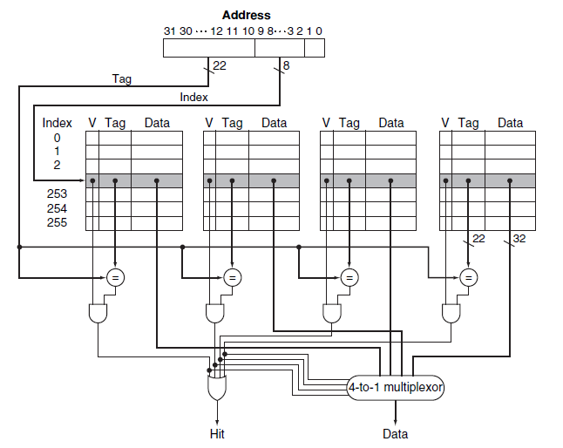
four-way set-associative cache

